Slide 2
Digital Forensics Lecture-10
By- Dr.subhranil Das
Assistant Professor
School of computer Science

Slide 3

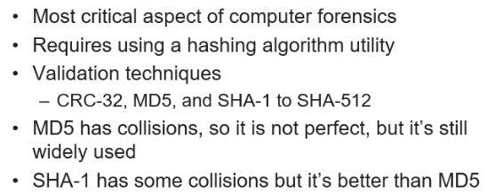
Validating Data Acquisitions

Slide 4
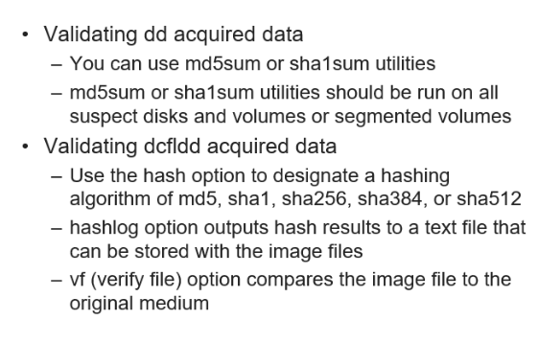
Linux Validation Methods

Slide 5
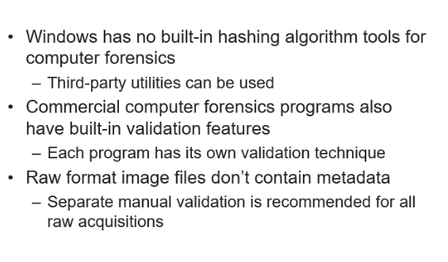
Windows Validation Methods

Slide 6
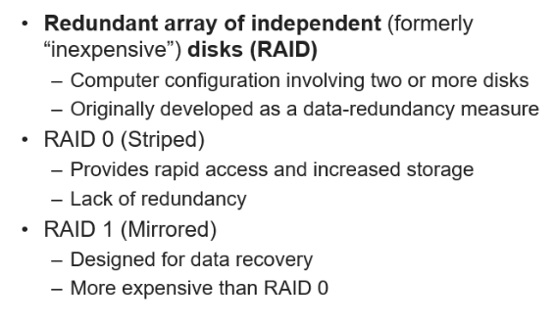
RAID Data Acquisition

Slide 7
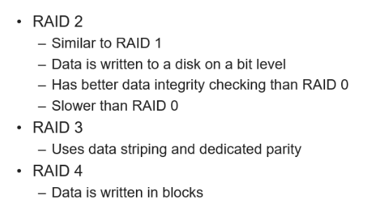
RAID Data Acquisition

Slide 8
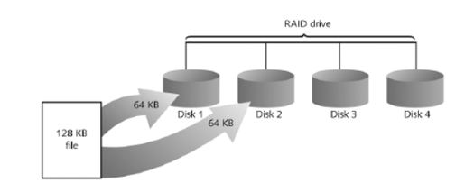
RAID Data Acquisition: Stripping

Slide 9
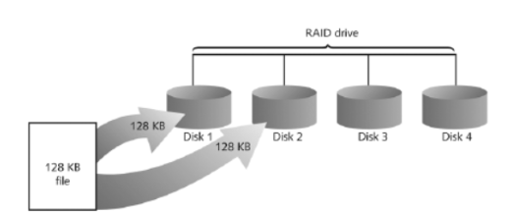
RAID Data Acquisition: Mirroring

Slide 10
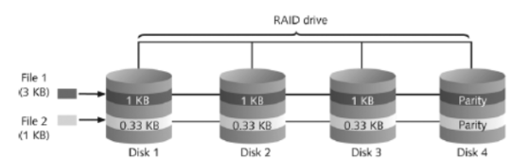
RAID 2: Striping Bit level

Slide 11
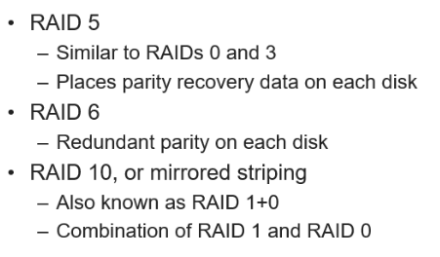
Understanding RAID

Slide 12
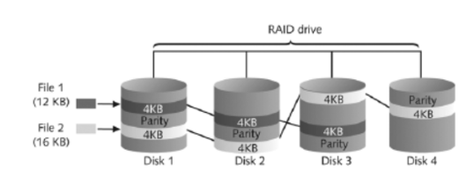
RAID 5: Block level stripping

Slide 13
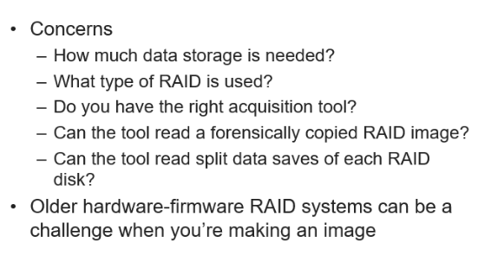
Acquiring RAID Disks

Slide 14
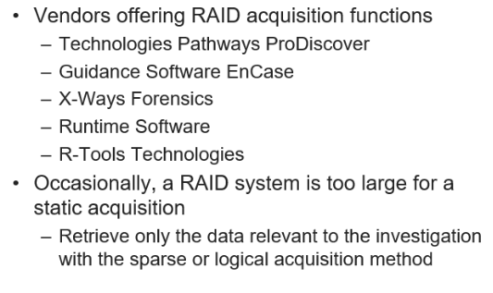
Acquiring RAID Disks

Slide 15
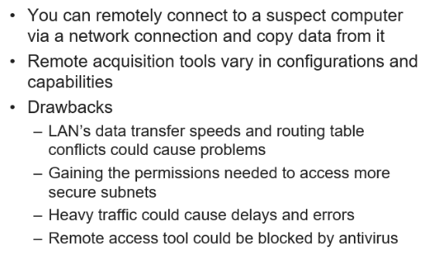
Remote Network Acquisition Tools

Slide 16
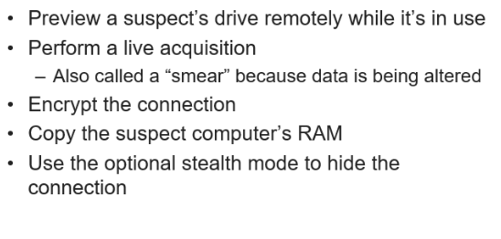
Remote Acquisition with ProDiscover Investigator

Slide 17
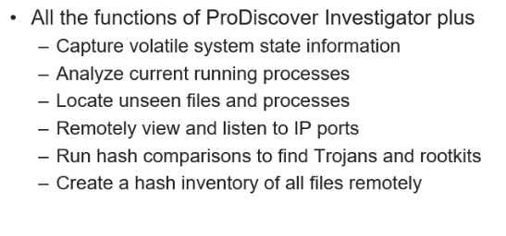
Remote Acquisition with ProDiscover Incident Response

Slide 18
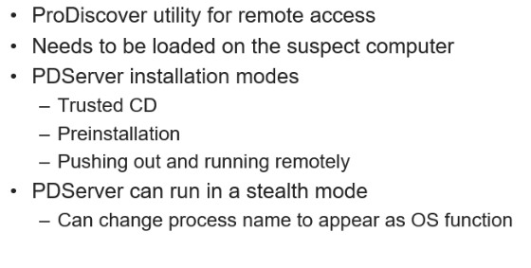
PDServer Remote Agent

Slide 19
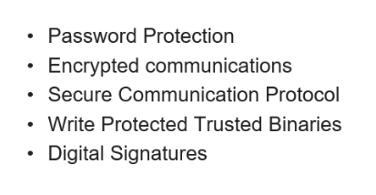
Remote Connection Security Features

Slide 20
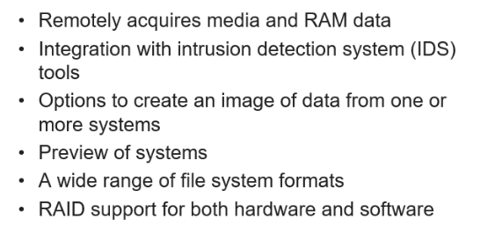
Remote Connection with Encase Enterprise

Slide 21
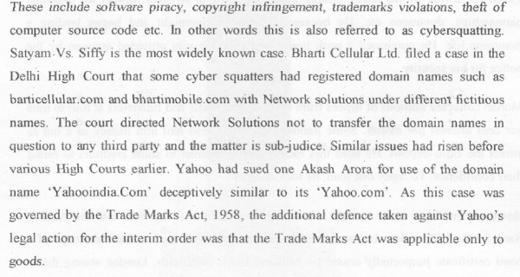
Case 7: Intellectual Property Fraud

Slide 22
Next Lecture
Digital Evidence Acquisition

